Slide 1
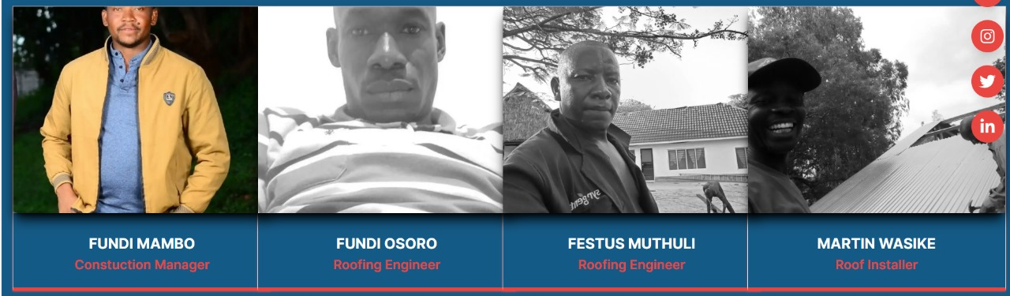
Font colour

Slide 2
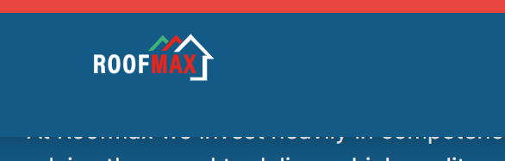
Enlarge Logo size, Make red contrast better with background

Slide 3
Link WhatsApp link email

Slide 4
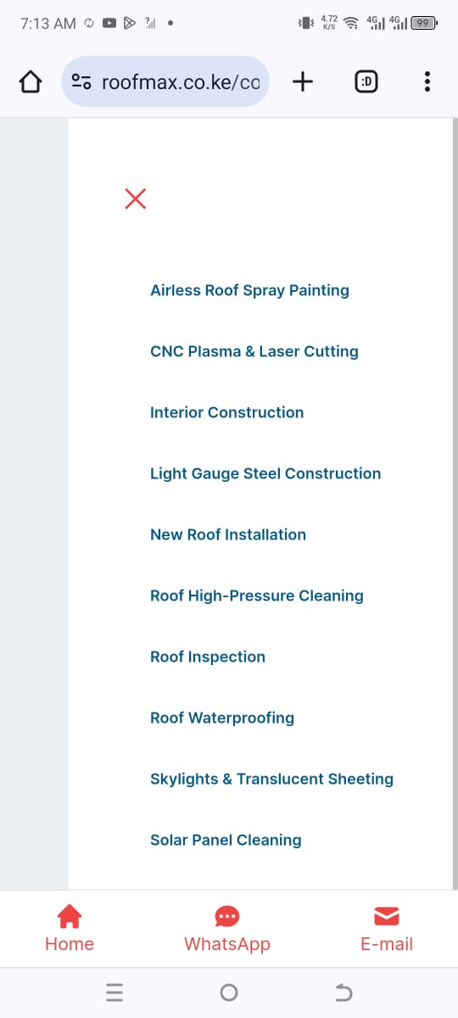
LOGO

